Slide 1
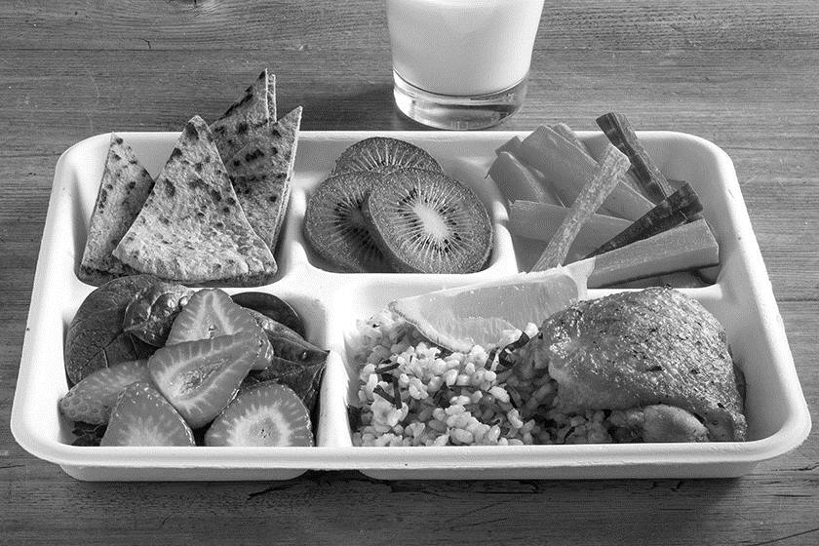
GREEN FOOD PURCHASING PROGRAM
Alyssa Wooden, Green Food Program Analyst
DC Department of Energy and Environment

Slide 2
What is the Green Food Purchasing Program?
The Green Food Purchasing Amendment Act of 2021 requires DOEE and covered agencies to:
Establish a baseline assessment of food-related greenhouse gas emissions (2021)
Track food-related emissions annually
Meet emissions reduction targets:
By FY25, a 10% reduction;
By FY27, an 18% reduction; and
By FY30, a 25% reduction.
@DOEE_DC
Notes:
Law applies to food purchases over $10,000, so we looked at agencies that purchased at least $10,000 worth of food in the baseline year – DCPS and DOC
These targets align with the target set by the Coolfood pledge, which is an initiative of the World Resources Institute in which organizations sign on and commit to reducing their GHG emissions. About 60 organizations, including DC as well as other cities, universities, healthcare organizations, and corporations, have signed the pledge.

Slide 3
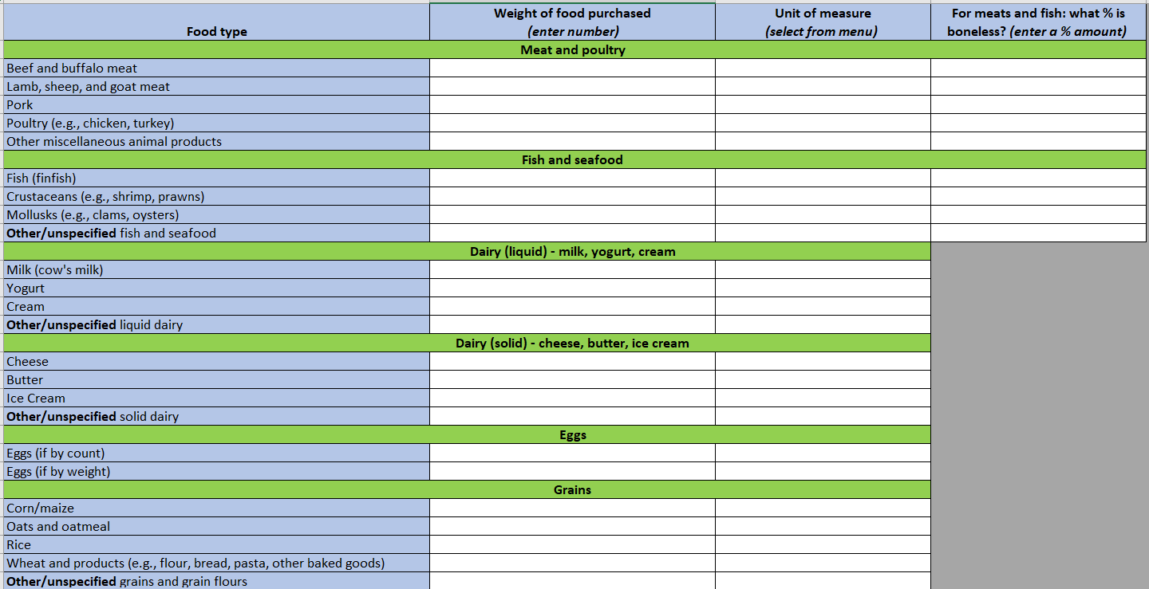
Tracking Food-Related Emissions
As a Coolfood member, DOEE collects food procurement data and submits it to WRI
WRI calculates associated GHG emissions
Tool: Coolfood tracking sheet provided by WRI
@DOEE_DC
Notes:
WRI also helps DC track its food-related emissions. Each year, DOEE calculates the number of pounds of each category of food purchased by each covered agency, inputs the numbers into this tracking sheet, and submits it to WRI.

Slide 4
Washington D.C.: total food-related GHG emissions (2021
baseline)
Food purchases (2021)
Total food-related GHG emissions
2,584 tons
29,781 tons CO₂e
Roots/tubers
5%
Vegetable oils 1%
Coffee, tea, spices 1% Ruminant meats 2%
Fruits & vegetables
Vegetable oils 2%
Coffee, tea, spices
5%
5%
Roots/tubers
Dairy 16%
1%
Beef
Legumes/nuts/seeds
Pork
1%
3%
Grains
4%
Eggs
Other animal- based foods
Poultry 12%
Seafood
2%
Ruminant meats
36%
2%
Plant proteins
Fruits & vegetables
43%
Seafood
Other-plant-based
1%
Poultry 20%
foods
Grains 13%
Eggs
2%
Dairy 18%
Le gumes/nuts/seeds
3%
Pork 2%
Source: Emission factors from Poore and Nemecek (2018) (agricultural supply chain) and Searchinger et al. (2018) (carbon opportunity costs).
Notes:
The chart on the left shows the District’s food purchases by weight, broken down by category – of the 2,600 tons purchased, fruits & veg is the largest category, followed by dairy, grains and poultry
The right chart shows GHG emissions associated with each food category – even though red meat was only 2% of purchases, it caused 36% of emissions.

Slide 5
Best practices for reducing emissions
Require vendors to report food purchasing data annually to DOEE
Reduce red and processed meat and increase offerings of plant-based foods
No more than 2 servings/week of red meat
No more than 1 serving/week per meal type of processed meat
All meals must include at least one plant-based option
@DOEE_DC
Notes:
We drafted language that agencies can insert directly into their food service contracts in order to incorporate these best practices

Slide 6
Unhealthy Diet Contributes to Many of the Leading Causes of Death in DC
Leading Causes of Death, District of Columbia, 2020
Source: CDC WONDER
Notes:
We reached out to DC Department of Health to provide input on the guidelines and to consult on how the Green Food program might impact public health in the District. Reducing consumption of red meat, particularly when it is replaced with healthier protein options such as legumes, nuts, and seafood could mitigate some of these leading causes of death, especially in vulnerable and marginalized communities.

Slide 7
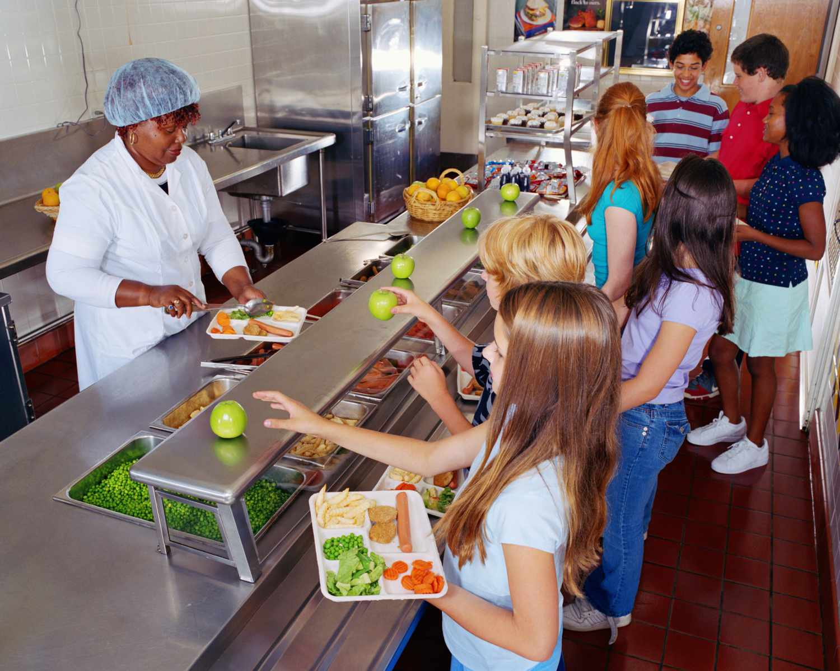
Challenges
Lack of complete 2021 food procurement data
Complex procurement process/regulation landscape
Acceptability of plant-based offerings
@DOEE_DC
Notes:
Not every agency was able to provide weight or volume of every food item purchased in 2021, so we had to make some estimations to get the data into the format WRI required to do the baseline emissions calculation, but
5 year contracts – more difficult to amend in the middle of that cycle
USDA Nutrition standards for school meals and DC Healthy Schools Act, however after reviewing these requirements we found that the meat reduction guidelines we developed do not conflict with these other nutrition requirements
We hope to continue to work with agencies to develop menu items that are low-carbon, nutritious, and acceptable to the residents who consume them.

Slide 8
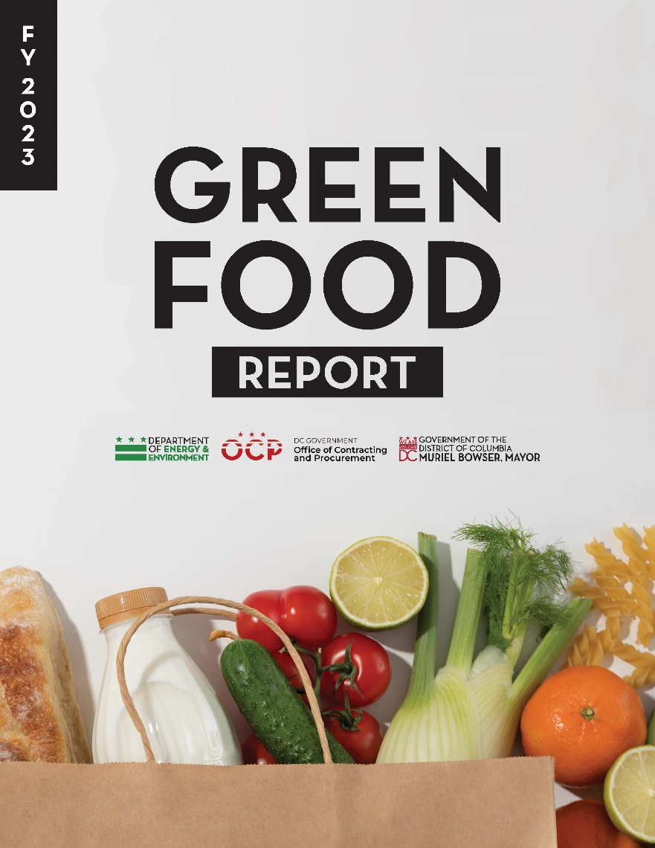
Successes
Baseline emissions assessment
Dissemination of Green Food contract guidelines
Partnership with DC Health
Briefing for agencies and food vendors with WRI
Publication of first Green Food report
@DOEE_DC

Slide 9
Q&A
@DOEE_DC

Slide 10
Thank you!
Alyssa Wooden
alyssa.wooden@dc.gov
@DOEE_DC

