Slide 1
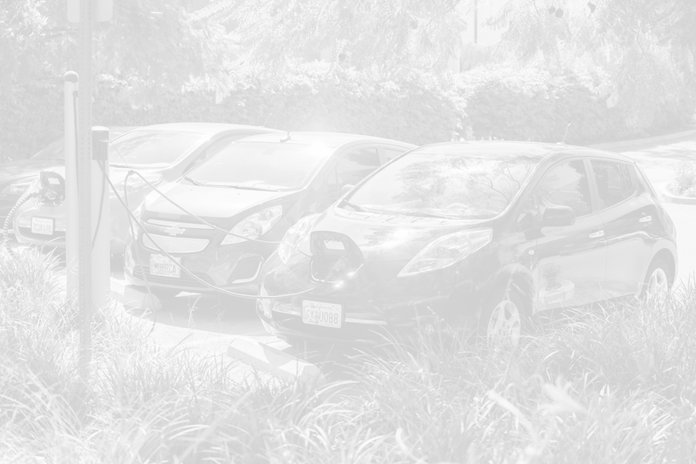
Electric Vehicles & Charging in the District of Columbia

Slide 2
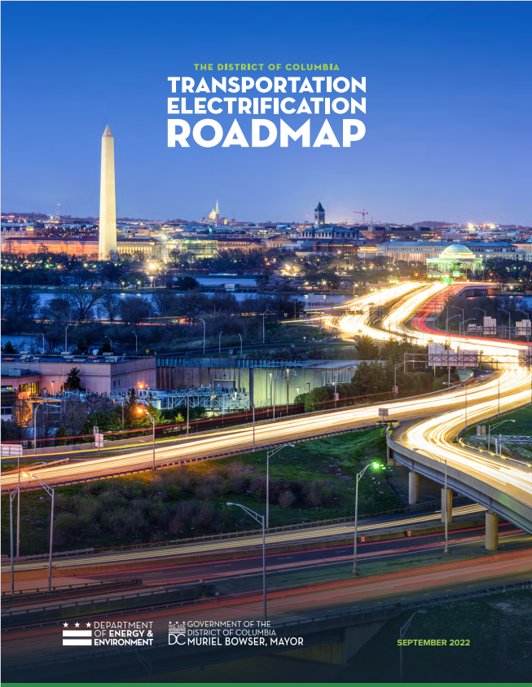
Roadmap published Late 2022
Notes:
Electric Vehicles Resources | doee (dc.gov)

Slide 3
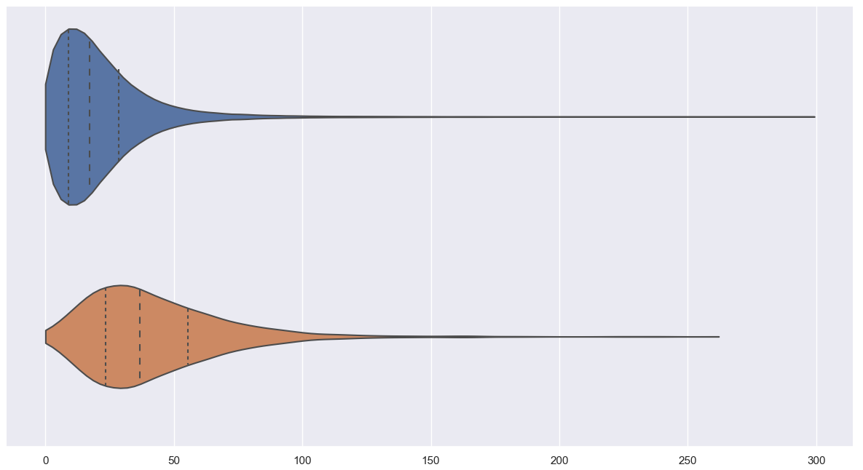
VMT profile of DC drivers
LDVs
Basic Statistics on DC Vehicles​
​
280K total registered vehicles in DC​
20K DC residents regularly drive out of DC​
200K non-DC residents regularly drive into DC
Taxis
Average daily Vehicle Miles Traveled
LDV = Light Duty Vehicle
@DOEE_DC
Notes:
VMT = Vehicle Miles Traveled

Slide 4
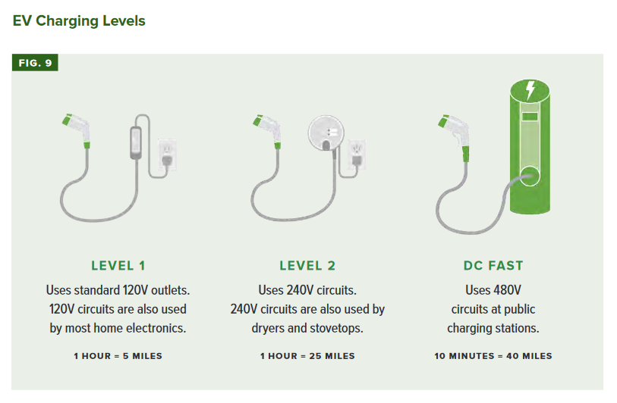
(LEVEL 3)
@DOEE_DC
@DOEE_DC
Notes:
DOEE received funding to complete a citywide climate adaptation plan from the Sustainable DC Innovation Fund in FY2013.
DOEE then awarded a grant in April 2014 to develop a plan to include:
1)The development of local climate change scenarios
2)An assessment of risks and vulnerabilities with a focus on critical facilities and infrastructure
3)A plan that will identify and prioritize adaptation solutions

Slide 5
DC Electric Vehicle Registrations
Calendar Year | Electric Vehicles* Registered (end of CY) | Growth Over Prior Calendar Year | % Increase
2020 | 2,271 | - | -
2021 | 3,768 | 1,497 | 66%
2022 | 5,325 | 1,557 | 41%
2023 | 7,482 | 2,157 | 41%
*Battery Electric Vehicle private passenger cars
Goal: 25% of all registered vehicles in the District as zero emission by 2030
Status: 2.6% of private passenger vehicles registered are EV as of 12/31/23 (not including 3,476 Plug In Hybrids per the Electric Power Research institute)
@DOEE_DC
Notes:
TER goal: 25% of the registered vehicles in the District as EVs by 2030

Slide 6
EV Chargers in DC per US DOE
Active Public Chargers (as of 2/10/24)
Level 1 |  | Level 2 |  | DC Fast Charge (L3)
stations | ports | stations | ports | stations | ports
1 | 2 | 325 | 989 | 11 | 63
Total Stations |  | 337
Total Ports |  | 1,054
Active Private Chargers (fleet & federal)
Level 1 |  | Level 2 |  | DC Fast Charge (L3)
stations | ports | stations | ports | stations | ports
7 | 23 | 40 | 107 | 1 | 2
Total Stations |  | 48
Total Ports |  | 132
@DOEE_DC

Slide 7
District of Columbia Electric Vehicle Incentives
Excise Tax – New or used fully-electric vehicles are exempt from DC Excise Tax (otherwise 1% to 10.1% of vehicle purchase price depending on weight/mpg)
Annual Registration - $36 registration fee for 1st 2 years, subtract 1,000 pounds afterward (otherwise $72 annually for Class I up to 3,499 lbs, $175 for Class 2 up to 4,999 lbs)
Alternative Fueling Infrastructure Credit - 50% of the allowable costs for the purchase/installation of charging stations. Shall not exceed $1,000 per station at a private residence; $10,000 per station on non-residential property designed for public use. (149 tax filers claimed this credit for tax year 2019)
Alternative Fueling Conversion Credit – 50% of the allowable costs for the conversion of a gasoline vehicle to an electric vehicle, up to $19,000.
@DOEE_DC

Slide 8
Pepco Electric Vehicle Incentives (EV Smart)
Whole House Time of Use Rate – rate (R-PIV) allowing residential ratepayers to save money when charging during off-peak hours, when electricity prices are lower.
Public Charger Program – Pepco installs utility side infrastructure to support 70 public Level 2 EVSE & 20 public Level 3 EV chargers
Public Transportation Charger Program - Pepco installs utility side infrastructure to support taxi or public bus charging
Multi-Dwelling Unit Rate – A special rate (MDU-PIV) for separately metered EV charging at apartments, condominiums and cooperatives. Includes seasonal, peak and off-peak components for cheaper charging from 8pm-6am. Avoids expensive demand charges normally charged for commercial accounts.
@DOEE_DC

Slide 9
Federal EV incentives
Vehicle Tax Credit - credit up to $7,500 for new qualified vehicles/purchasers; qualified used EV’s/EV purchasers may be eligible for one-time $4,000 credit.
Alternative Fuel Vehicle Refueling Property Credit – nonrefundable tax credit of 6% to 30% of the hardware and installation costs for EV chargers in certain census tracts. Maximum of $100,000 or $1,000 if installed at a residence.
Inflation Reduction Act – Home Electric Upgrades
Home Energy Rebates – Around $60m to be administered by DOEE
Electric Panel Upgrade - up to $4,000
Electric Wiring Installation – up to $2,500
Electrification Tax Credit – electric panel ($600)
@DOEE_DC

Slide 10
Other Electric Vehicle Charging Incentives
Mid-Atlantic Electrification Partnership – Federal grant-funded program to install subsidized public Level 2 EV chargers in DC, MD, VA & WV. Administered by Greater Washington Clean Cities Coalition and related organizations. Blink and Greenspot provide the chargers & services.
Charging Infrastructure Deployment in Underserved Latino Multi-Family Housing Communities – Federal grant-funded program to install subsized Level 2 EV chargers in DC, MD & VA. Administered by Citizen Energy.
General Motors Dealers Program – National GM program for car dealers to install subsidized EV chargers in the community.
@DOEE_DC

Slide 11
EV Market & Charging Needs
DC Council Legislation 25-0106
“Comprehensive Electric Vehicle Infrastructure Access, Readiness, and Sustainability Amendment Act of 2023”
Public hearings held July 2023
Right to charge (tenants & condo owners)
DDOT infrastructure pilot program for neighborhood chargers
Anticipates PSC approval of additional Pepco programs to subsidize installation of EV charging infrastructure on private property
Grid capacity study
EV chargers & EV ready required in parking areas of new buildings
@DOEE_DC

Slide 12
EV Market & Charging Needs
Federal CFI Program (DOEE)
Charging and Fueling Infrastructure discretionary grants
Community and Corridor Charging
$700M first round of applications were due June 2023 and awarded Jan 24, 2024
$15M maximum award per application
DOEE applied to 1st round but was not funded
Second round expected Spring/Summer 2024. DOEE intends to apply
@DOEE_DC
Notes:
NEVI (dc.gov)

Slide 13
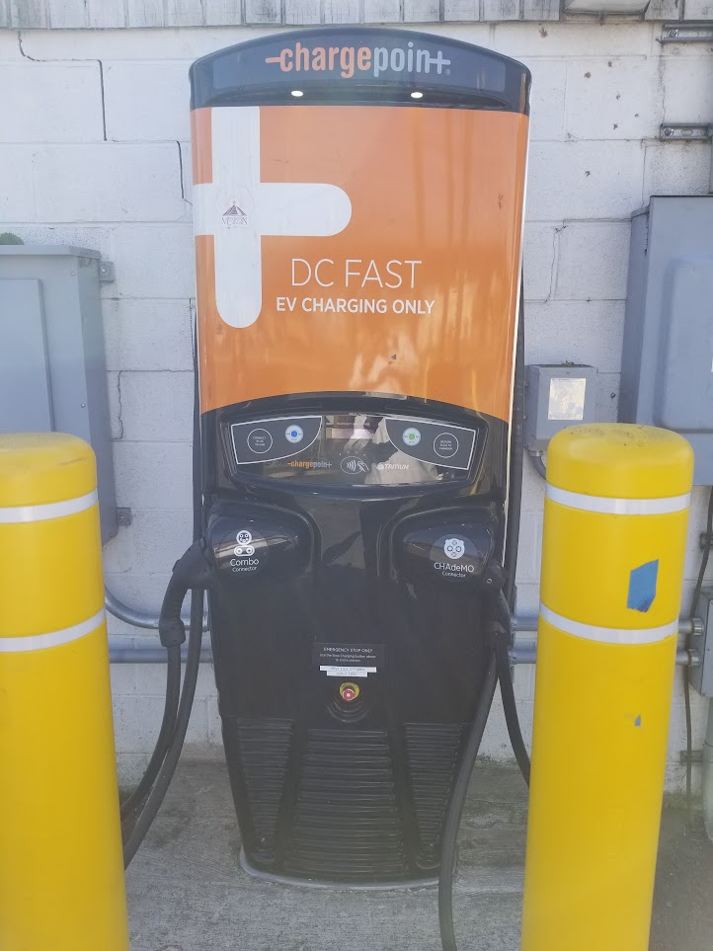
Federal Electric Vehicle Charging Reliability & Accessibility Accelerator grant program
In January 2024, DOEE won a grant to replace a broken DC fast charger (Level 3) at 3355a Benning Rd NE on Transco (DC Cab) property
Originally installed in 2018 by DOEE with DFHV to serve the public as well as taxis
Upgrade from single 50kW charging port to four 150kW charging ports
Corridor option (close to I295)
$820K project cost
$588K federal funds requested
DC Green Bank option
Local match includes up to $110K from Pepco for customer make-ready work
@DOEE_DC

Slide 14
Questions? Al Carr Policy Analyst alfred.carr@dc.gov

