Slide 1
DISTRICT DEPARTMENT OF TRANSPORTATION
NEVI Program Updates
Commission on Climate Change & Resiliency (CCCR)
Quarterly Public Meeting
March 14, 2024

Slide 2
Agenda
NEVI Program Overview
Eligible Locations
NEVI-Compliant Station Requirements
Stakeholder Engagement
Program Timeline
Q&A

Slide 3
NEVI Program Overview
Purpose:
Accelerate the adoption of EVs
Create a reliable network of EV charging stations to reduce range anxiety
Reduce greenhouse gas (GHG) emissions
Funding:
~$16.7M over five years

Slide 4
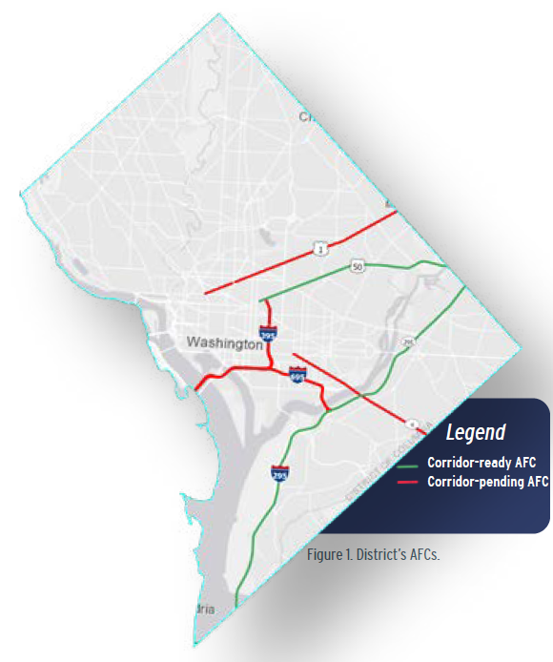
Alternative Fuel Corridors (AFCs)
AFC | Corridor Limits |  | Status
New York Ave (US-50) | 5th St NW | DC-Maryland NE Boundary | Ready
I-295 and Anacostia Freeway (DC-295) | DC-Maryland SE Boundary | DC-Maryland NE Boundary | Ready
I-395 and I-695 | DC-Virginia SW Boundary | New York Ave and I-295 | Pending
Rhode Island Ave (US-1/US-29) | Connecticut Ave NW | DC-Maryland Boundary | Pending
Pennsylvania Ave SE | Independence Ave SE | DC-Maryland SE Boundary | Pending

Slide 5
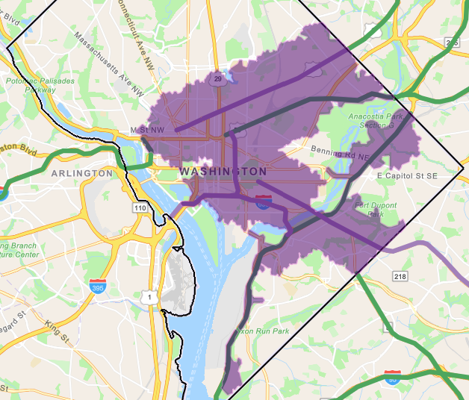
Eligible Locations
Within 1 travel-mile of the AFCs (purple on map)
DDOT’s NEVI Site Mapping tool: https://nevi.ddot.dc.gov/pages/nevi-eligible-locations

Slide 6
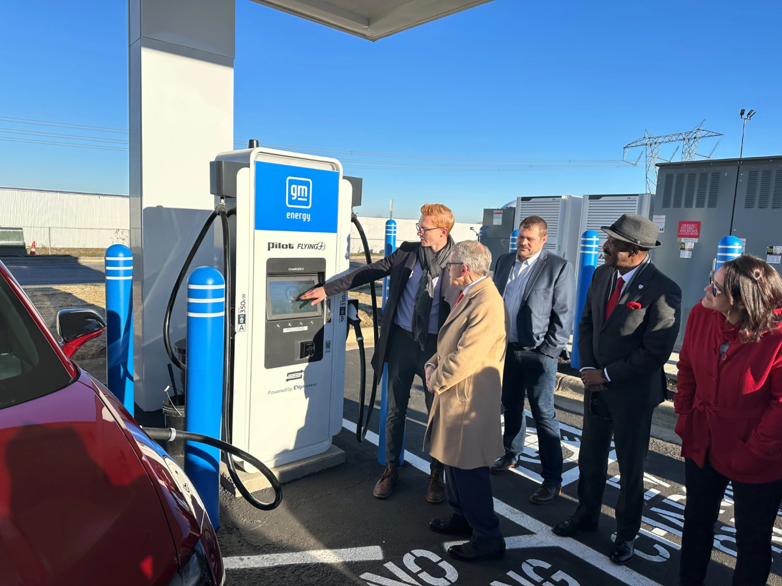
Minimum Specifications for Direct Current (DC) Fast Chargers
Minimum four ports which must be capable of charging a Combined Charging System (CCS) compliant electric vehicle.
Every charging station along Alternative Fuel Corridors must be publicly available 24/7.
Each charging port must have an average annual uptime greater than 97%.
Charging stations must provide a contactless payment method that accepts major credit and debit cards.
Ohio DOT opens first NEVI compliant charging station.

Slide 7
Stakeholder Engagement
Partnership Facilitation Tool to connect potential site hosts and Applicants
Link to survey and results: https://nevi.ddot.dc.gov/pages/resources
Coordination with the Department of Energy and Environment (DOEE) on EV-specific outreach
Future engagement on public experience after initial NEVI chargers are installed

Slide 8
Program Timeline
March 28, 2024 – Virtual public meeting targeting potential site hosts
March 29, 2024 – Request for Applications (RFA) published
May 24, 2024 – Applications due to DDOT
Summer 2024 – Finalize application evaluation
Fall 2024 – Grants awarded
2025 – First District NEVI Chargers to open!

Slide 9
Questions?
Tasin Malik
NEVI Program Manager
nevi@dc.gov
https://nevi.ddot.dc.gov/

Slide 10
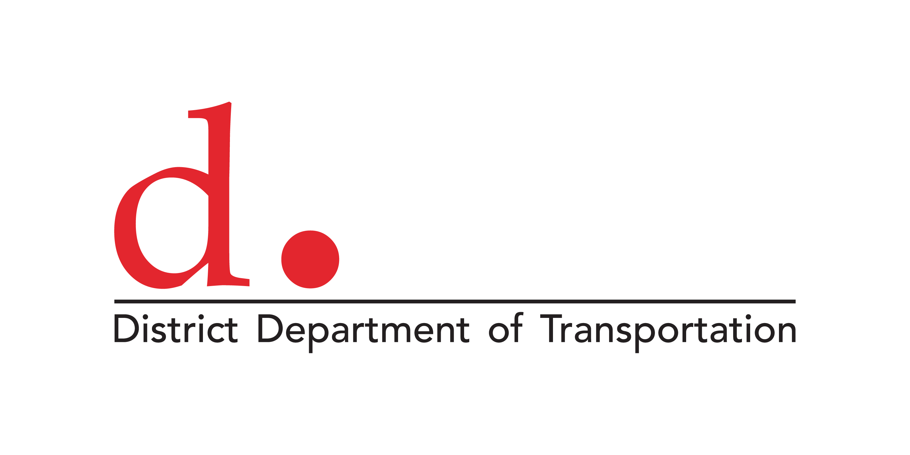
250 M St SE | Washington, DC 20003 | 202.673.6813

