Slide 1
District of Columbia Commission on Climate Change & Resiliency Quarterly Meeting
Staff Updates December 14, 2023

Slide 2
Headline News
Carbon Free DC
Mayor Bowser attended COP28 in Dubai and announced the release of the Carbon Free DC strategy.
Carbon Free DC is the District’s strategy to reach carbon neutrality by 2045.
Press release
StoryMap
Full plan and other resources

Slide 3
DOEE Updates
Happening at DOEE
New releases:
Green Food Report
Updates underway:
Clean Energy DC 2.0
Sustainable DC 3.0
Federal funding in the District
Climate Pollution Reduction Grant
Climate Ready DC – Climate Projections Update
Notes:
Green Food Report
The District's first Green Food Report was published on December 1. The report includes baseline calculations of the emissions from food purchased by District government agencies.
Clean Energy DC 2.0
The CEDC 2.0 team has released a draft policy roadmap for public review and input.
Sustainable DC 3.0
The Sustainable DC team completed two projects, with consultant support, to develop recommendations for further enhancing equity and improving quantitative targets in the forthcoming Sustainable DC 3.0 Plan. The team has transformed these recommendations into draft revisions to the existing goals, targets, and actions in the plan and shared those draft revisions with implementing agencies for review. Once feedback is incorporated, the Sustainable DC team will begin developing a full draft of Sustainable DC 3.0, with the goal to submit it for Mayoral review in May 2024.
Federal funding in the District
DOEE has published a webpage showing recent and upcoming awards of federal funds flowing into the District.
Climate Pollution Reduction Grant
DC received $3M from the CPRG to work on climate planning earlier this year. $1M of that has been awarded to MWCOG to work on regional climate planning. DOEE is currently drafting its Priority Climate Action Plan, due March 1st. The PCAP is being informed by the CEDC 2.0 public engagement process and input from District agencies.
Climate Ready DC – Climate Projections Update
DOEE and HSEMA have completed a draft update to the District's climate change projections. The two agencies are now convening multiple other agencies to discuss the findings and discuss how best to report progress on Resilient DC and update Climate Ready DC.

Slide 4
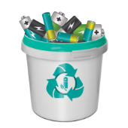
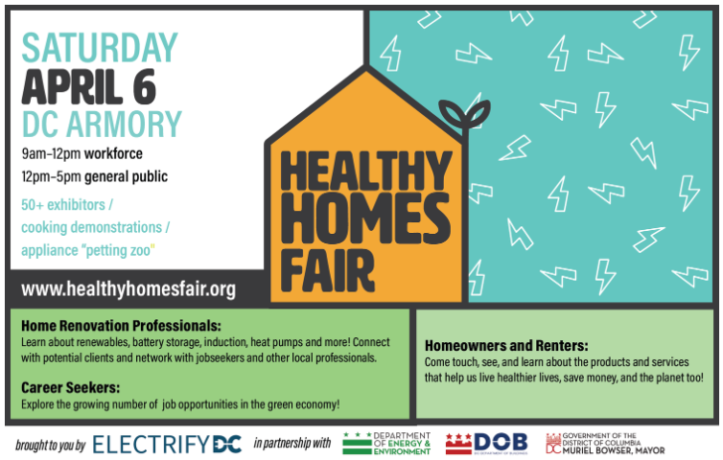
District Updates
Happening around the District
DC Flood Task Force Final Report
Call2Recycle - Battery Recycling Program Launched
Electrify DC Healthy Homes Fair – April 6, 2024
PSC Formal Case 1142 – breach of WGL merger agreement
Notes:
DC Flood Task Force Final Report
Between September 2021 and January 2023, the Task Force and Action Teams met 32 times and hosted public listening sessions to investigate potential actions. Based on these conversations, the Task Force recommended 27 actions for submission to the City Administrator, which include proposals to:
• Update the District’s flood maps to account for climate change and interior flooding.
• Repair and upgrade homes to be more flood resilient.
• Install neighborhood-scale flood infrastructure.
• Improve internal District agency processes for flood related permitting and complaint resolution.
• Increase availability and affordability of flood insurance.
Battery Recycling Program
As of November, consumers in the District can now drop off household batteries for recycling at designated sites throughout the city. The program was developed in compliance with District law and regulations by Call2Recycle, the District’s battery stewardship organization, on behalf of battery manufacturers. The collection sites accept both single-use and rechargeable batteries at no cost to consumers for collection and recycling. DOEE oversees the program. A map of the initial collection sites can be found on Call2Recycle’s locator webpage. The program is still adding collection sites, so monitor the online map to learn about new participating locations. For more details, visit Call2Recycle’s District program webpage.
Save the Date for Healthy Homes Fair on April 6
Join DOEE and Electrify DC, a leading non-profit dedicated to home electrification, as a sponsor of the inaugural Healthy Homes Fair - a full-day expo and interactive learning experience for 1,000+ home renovation professionals, career seekers, homeowners, and renters. By becoming a sponsor, you can prominently showcase your products and services and play a pivotal role in promoting home electrification and building a cleaner, more sustainable DC. Sign Up Today to sponsor or exhibit. Early Bird Pricing Available until Friday, January 12th, 2024. Contact vanessa@electrifydc.org with questions.
The Healthy Homes Fair is a full-day interactive event and expo that provides 1,000+ home renovation professionals, career seekers, homeowners, and renters an interactive space to learn and experience the power of electrification. This event increases awareness of products and services needed to accelerate the decarbonization of our homes and the incentives available to do so. The Fair is organized by Electrify DC, a nonprofit that is transforming the residential real estate market and the professions that serve it by bringing together real estate professionals, contractors of all kinds, government agencies, and the public to showcase the cost savings, health and climate benefits of electrification through education, training, and advocacy. In the morning, the Fair will serve as a training ground for professionals, businesses, and people looking to join the clean energy workforce. In the afternoon, the Fair will empower homeowners and renters to make the transition to clean energy by showcasing products and services including heat pumps, induction cooktops, heat pump water heaters, heat pump dryers, EV chargers, battery storage, small plug-in vehicles, electric lawn tools, electrical panel components, rooftop solar, and other renewable energy solutions.
PSC Formal Case 1142
Earlier this year, the District of Columbia Public Service Commission in Formal Case No. 1142, held that AltaGas had breached Term No. 5 of the 2018 Settlement Agreement regarding a merger between AltaGas and WGL Holdings Inc. (the parent company of Washington Gas Light Company). Term 5 required AltaGas to develop or cause to be developed 10 MW of electric grid energy storage or solar generation by July 6, 2023. AltaGas purchased 2.4 MW of solar renewable energy credits (SRECs) by July 6, 2023, in furtherance of its Term 5 obligation, but failed to cause to be developed 7.6 MW of its 10 MW responsibility. The Commission directed AltaGas and the District of Columbia Government (DCG) to reach a compromise penalty amount under DC Code § 34-706 for AltaGas’s breach of Term 5. On November 14, 2023, the District of Columbia Office of the Attorney General, for DCG, informed the Commission that DCG and AltaGas had been unable to reach a compromise. On November 21, AltaGas filed a motion proposing a penalty for its breach of Term 5, which would provide it more time to cause to be developed the outstanding 7.6 MW of solar generation along with quarterly noncompliance payments until the full 10 MW is caused to be developed. On November 28, 2023, the Commission provided parties to Formal Case No. 1142, 15 business days – until December 19 – to file comments on AltaGas’s proposed penalty motion and reply comments will be due 30 business days after November 28.

Slide 5
CCCR Engagement
CCCR External Engagement
Southwest Neighborhood Assembly – Climate Action & Disaster Preparedness Fair
Greenbuild
Downtown Action Agenda Steering Committee
UN Conference of Parties (COP 28)
DC Water Northeast Boundary Tunnel ribbon cutting
DC Water Fleet: Fuel Transition stakeholder engagement
Chesapeake Bay Foundation training series

Slide 6
Administrative Updates
Administrative
Coming soon – Job posting for CCCR staff position
CCCR vacancies
Emergency Preparedness
Public Health
Notes:
Two CCCR vacancies:
-Emergency Preparedness and Public Health
-Seeking candidates who live in the District, preferably with deep local roots.
-Send candidate recommendations to Uwe.

Slide 7
Next Meeting
Thursday, March 14, 2024

