Slide 1
District of Columbia Commission on Climate Change & Resiliency Quarterly Meeting
Staff Updates June 13, 2024

Slide 2
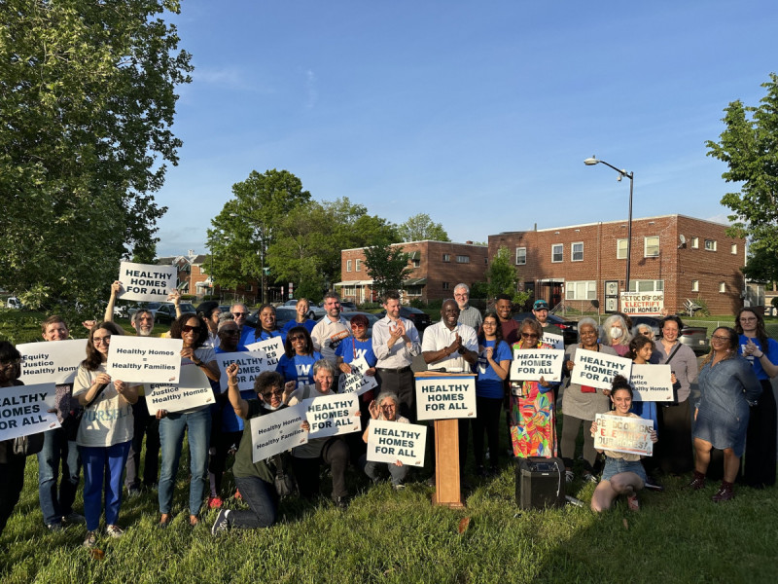
Headline News
Healthy Homes Act Passes
May 7 - D.C. Council voted unanimously to pass the Healthy Homes Act.
Will provide residential electrification retrofits for 30,000 low- and moderate-income District households by 2040.
Notes:
Healthy Homes Act
The D.C. Council voted unanimously in May 7 to pass the Healthy Homes Act, legislation that will replace fossil-fuel powered appliances and home heat with efficient electric appliances for 30,000 low- and moderate-income District households by 2040. These home electrification retrofits should save households between $200-600 a year in utility bills, with additional savings if combined with solar energy. It was enacted without the Mayor’s signature.
The bill was introduced and spearheaded by Councilmember Charles Allen, and co-sponsored by seven other Councilmembers: Matthew Frumin, Brooke Pinto, Zachary Parker, Brianne Nadeau, Robert White, Vincent Gray, and Janeese Lewis George. The Healthy Homes Act also received vast community support, including from almost 40 organizations that signed a letter of support in September 2023.
DOEE will publish a plan to administer this program by the end of the fiscal year for 2024.
Beyond Gas DC is hosting a Victory Celebration Picnic at noon on June 15. For more information, register here: https://actionnetwork.org/events/healthy-homes-act-celebration

Slide 3
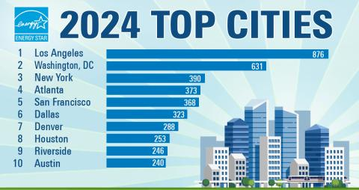
Headline News
DC Metro Area Ranks Top Two EPA’s 2024 List of Top Cities with ENERGY STAR Certified Buildings
Notes:
DC Metro Area Ranks Top Two EPA’s 2024 List of Top Cities with ENERGY STAR Certified Buildings
The Washington, DC area was ranked second in the U.S. Environmental Protection Agency’s (EPA) 2024 list of U.S. metropolitan areas with the most ENERGY STAR certified buildings. The ranking confirms the DC Metro Area’s commitment to providing building owners and managers with the technical guidance, best practices, and training they need to make their buildings more energy efficient, save money, and reduce carbon emissions. The District has held the top one or two spot on this list, periodically trading places with Los Angeles, since 2010.
Cities are ranked on the list according to how many buildings in their area achieved ENERGY STAR certification in 2023. To qualify for the ENERGY STAR, a building must earn a score of 75 or higher (on a scale from 1 to 100), indicating that it outperforms 75% of similar buildings nationwide. In 2023, 631 buildings in the DC area earned the ENERGY STAR, totaling more than 169 million square feet of certified floor area. Additionally, these certified buildings have helped prevent nearly 582,000 tons of greenhouse gases and saved building owners nearly $220 million in utility costs.
District of Columbia law requires buildings over 25,000 gross square feet to annually measure and report their energy and water performance for public disclosure. Calendar year 2011-2020 benchmarking data for nearly 2,000 public and private buildings is available through DOEE’s interactive mapping tool. Additionally, buildings over 50,000 square feet are now required to meet the District’s Building Energy Performance Standards, which were set on January 1, 2021.

Slide 4
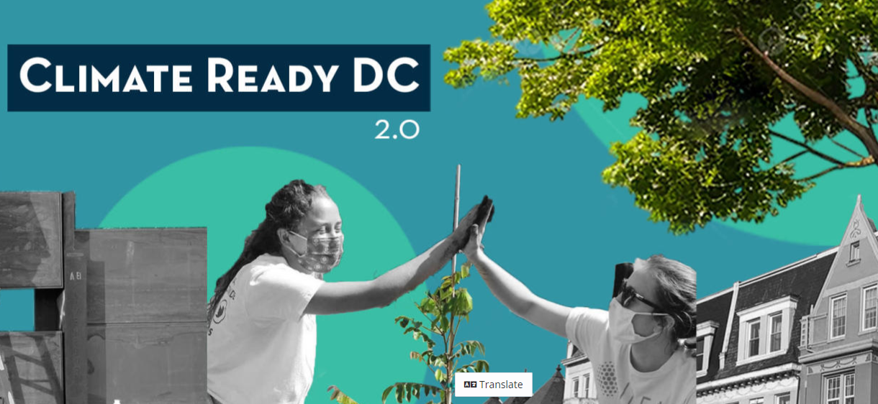
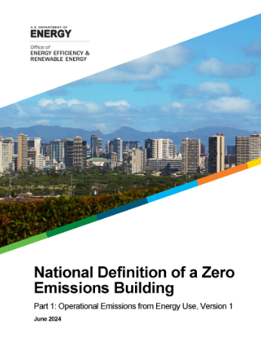
DOEE Updates
Happening at DOEE
DOEE Budget Oversight Hearing
Climate Ready DC – Update in progress
Climate Commitment Task Force
Green Buildings & Net-Zero Energy Codes
District Waterways Advisory Commission
Anacostia River Corridor Restoration Plan
RFA: DC Green Cleaning Program
RFI: Clean Energy Financing Program
Notes:
DOEE/CCCR Budget Oversight Hearing
On April 29, the heads of DOEE, DC Green Bank, and DC Water, testified in front of the DC Council Committee on Transportation and the Environment, chaired by Councilmember Charles Allen. The hearing included testimony from nearly 80 public witnesses.
As our work relates to climate…
Climate Ready DC Update
DOEE and HSEMA are currently collaborating on updating Climate Ready DC, the District's climate adaptation plan, and the climate adaptation chapter of Resilient DC. This update will incorporate new climate science, apply a racial equity lens and better help agencies achieve resilience targets. As part of this initiative, the District's climate change projections have been updated and I can follow up with a link to view them after this meeting. are available here [link incoming next week]. The agencies have also hosted two of four planned interagency workshops and are currently conducting a public engagement campaign. They are soliciting feedback via an online survey (link: https://engage.dc.gov/climateready#tab-51011), which you are invited to take and distribute to your networks.
Climate Commitment Task Force
Climate Commitment Interagency Taskforce launched May 1, 2024, with the goal to deliver an action plan to achieve carbon neutrality in District government operations by 2040, as part of the Climate Commitment Act of 2022. including timeline and estimated funding needed. The Climate Commitment Act of 2022 codified the District’s interim climate targets and a new interagency taskforce will work to deliver a roadmap to 2040. The District is committed to becoming carbon neutral and climate resilient by 2045, and achieving neutrality in its own operations by 2040.
If helpful, these meetings are open to the public and the work agencies are first doing is to pull together a scope of work to seek technical assistance to help us with the modeling and more granular look at DC Government operations that will help us identify the path forward and key milestones, much like DOEE did citywide with Carbon Free DC.
Green Buildings & Net-Zero Energy Codes
The US Dept. of Energy released a national definition of a zero emissions building, and GSA released new facility standards that will be a big step forward in federal building, design, construction and operation. We anticipate both are going to be helpful as the District works toward developing both a net-zero energy code and to look at embodied carbon as well as operational carbon. These also have goals of NZ water and NZ waste.
National Definition of a Zero Emissions Building—a building that is highly energy efficient, does not emit greenhouse gases directly from energy use, and is powered solely by clean energy.
The operational carbon footprint of a building is the sum of all the carbon produced over the lifetime use of the building, which could easily be 50 or more years. Embodied carbon is the carbon footprint of a building before it is built, and encompasses the greenhouse gasses emitted during the construction process.
District Waterways Advisory Commission
DC Council established the Office of District Waterways Management (Office) (see DC Law 24-336) to plan, promote, advocate for, and facilitate stakeholder cooperation for the diverse uses of and access to the Anacostia and Potomac River, the Washington Channel, and adjacent property. In particular, the Office seeks to facilitate better communication between the District, Maryland, Virginia, the federal government, businesses, community organizations, and the public on matters of public safety, the environment, recreation, and transportation.
The Commission will advise the Office and assist in the creation of a Waterways Advisory Plan (Plan) to set out a strategic vision for the Anacostia and Potomac Rivers, the Washington Channel, and adjacent property. If there is anyone you think could be a good addition to this commission, they can submit an application for a Mayoral appointment or a Chairman of the Council appointment on the ODWM website.
Anacostia River Corridor Restoration Plan
DOEE has released the Anacostia River Corridor Restoration Plan for public comment. This plan envisions a bold future for the Anacostia River - restoring the fish and wildlife habitat, improving water quality, adapting to climate change, and increasing equitable public access to the river corridor. Public comments are due by July 31.
Read more here: restoretheanacostiariver.com/anacostia-corridor-restoration-plan
Request for Applications – DC Green Cleaning Program
DOEE is pleased to announce the availability of a grant for the development and implementation of the District’s Green Cleaning Program (GCP). This initiative aims to support Cleaning Service Providers (CSPs) in disadvantaged communities, specifically in Wards 5, 7, and 8 of Washington DC, in transitioning to safer and more sustainable cleaning products. Funded by the US Environmental Protection Agency’s Fiscal Year 2023 Pollution Prevention Grant: Environmental Justice through Safer and More Sustainable Products, the GCP Request For Application (RFA) has $284,000 allocated for the project over 24 months. Applications are due June 17.
Request for Information – Clean Energy Financing Program
DOEE is requesting input from interested parties in the District to identify potential opportunities for financing under a State Energy Financing Institution (SEFI) program to inform DOEE program design and policy making. The period for RFI responses is open-ended. The Request for Information (RFI) seeks responses from clean energy project developers, asset owners, or other institutions looking to decarbonize their operations, financial institutions, and other relevant parties to:
1. Inform the design of financing efforts or other related activities led by DOEE, other instrumentalities of District Government, or other relevant government authorities operating within the District of Columbia that support decarbonization efforts within the District of Columbia.
2. To solicit initial feedback on the potential use of state funds from an established SEFI to implement the goals of DOEE and District Government, while leveraging federal financing from LPO. Specifically, input is requested that can inform how to best leverage the DOE LPO SEFI-Supported category of the Title 17 Clean Energy Financing Program. Through this program LPO can augment state-administered clean energy programs providing additional financial support to projects that align federal energy priorities with those of U.S. states like the District.

Slide 5
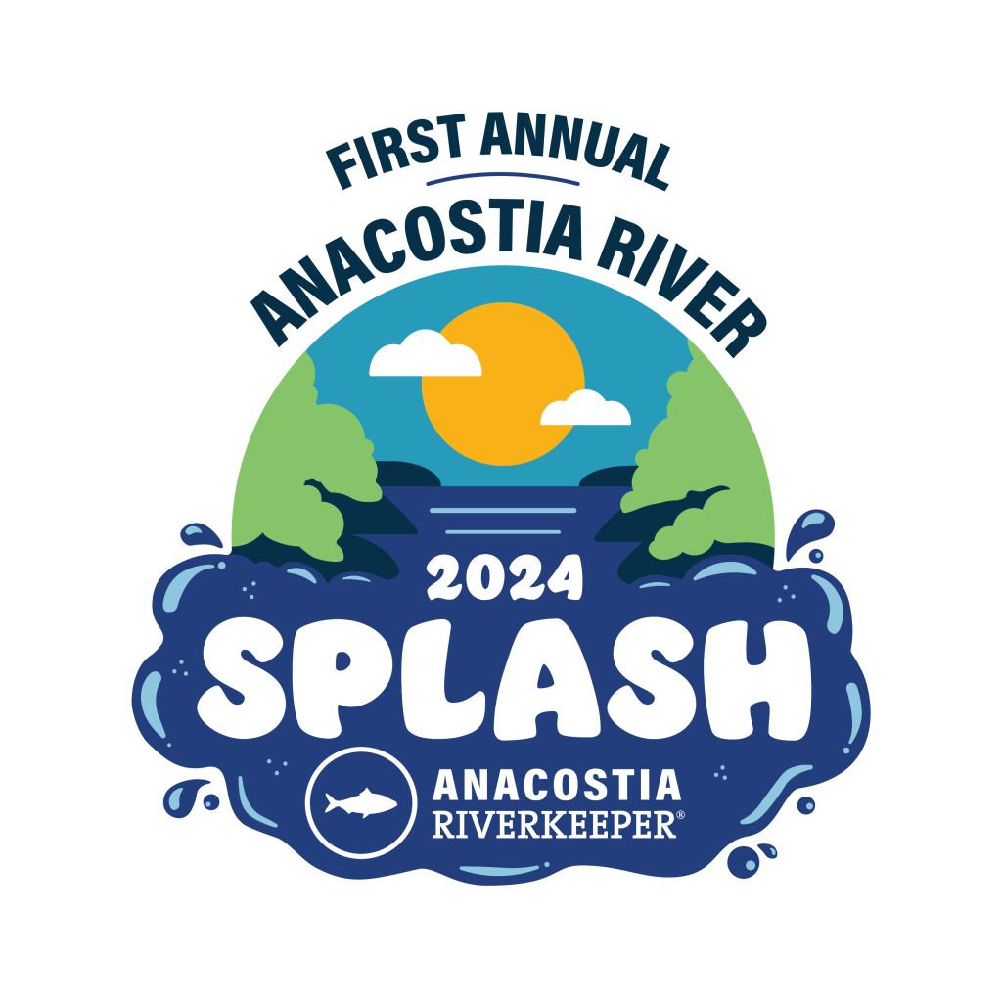
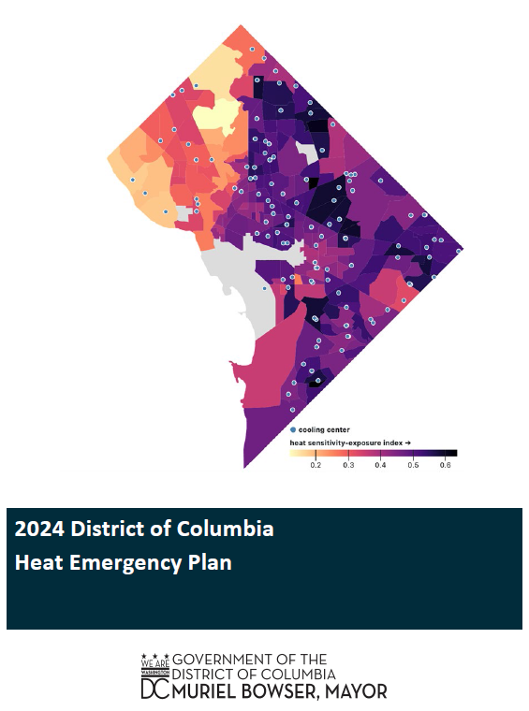
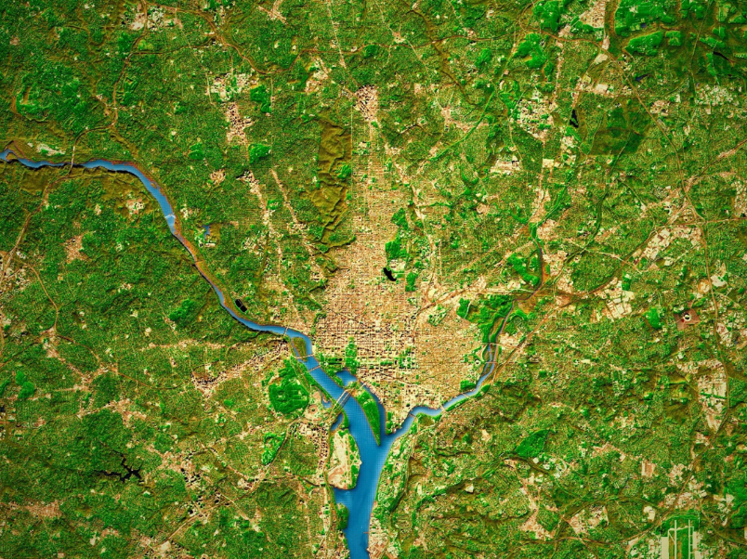
District Updates
Happening around the District
2024 District Heat Emergency Plan
COG Regional Tree Canopy Update
Anacostia River Splash – June 29
Notes:
District Heat Emergency Plan
HSEMA released the updated 2024 District of Columbia Heat Emergency Plan, which is implemented when the forecast of the temperature or heat index in the District is 95 degrees or higher. The plan activates cooling centers for community members to seek relief from the heat.
While several important updates have been made this year, the most significant change is the integration of a new ‘Extended Heat Emergency’ alert tier – when . This update was made in response to an EOM press release issued during the 2023 heat season that introduced the term ‘Hot Weather Emergency’ to describe circumstances in which the heat index is at or above 95⁰F for four consecutive days. The new ‘Extended Heat Emergency’ language codifies this concept in the Plan and brings our alert terminology into better alignment. This updated language can be found on Page 2 of attached document within the ‘Policies’ section.
In addition to the new alert tier, the updated plan contains expanded resource information for individuals experiencing homelessness, including a listing of Day Centers available as cooling centers, and an expanded list of youth services centers, among other additions.
As always, hours of operation for all facilities listed in the plan, along with District agency roles and responsibilities, have been updated based on information provided by our partners.
Tree Canopy Update
On April 10, the Council of Governments (COG) Board of Directors adopted a new regional tree canopy goal to maintain a minimum tree canopy coverage of 50 percent across the metropolitan Washington region. In 2023, the region's tree canopy experienced a slight drop from 2014 -- was estimated to cover 49.6 percent of the region, down from 51.3 percent in 2014. With 4,383 acres lost annually to development, coverage could drop to 44.4 percent by 2050 if this trend persists. The board is also calling on local jurisdictions to use Conserving Trees and Forests in Metropolitan Washington, a comprehensive, new COG report on the development of the goal, as a resource and reference document to aid the creation of an action plan guiding tree canopy efforts.
Anacostia River Splash
Anacostia RiverKeeper is hosting the inaugural Splash on June 29. This event gives DC area residents the chance to swim and reconnect with the Anacostia River – and make history at the first permitted swim in the Anacostia River in over 50 years. The general public can register for tickets starting June 10.
In 2018, the DC Department of Energy and Environment (DOEE) implemented an amendment to the swim ban to allow permitted swim events in District waters Anacostia. We are utilizing this process to host the inaugural Splash!

Slide 6
Next Meeting
Thursday, September 12, 2024

