Slide 1
District of Columbia Commission on Climate Change & Resiliency Quarterly Meeting
Staff Updates March 14, 2024

Slide 2
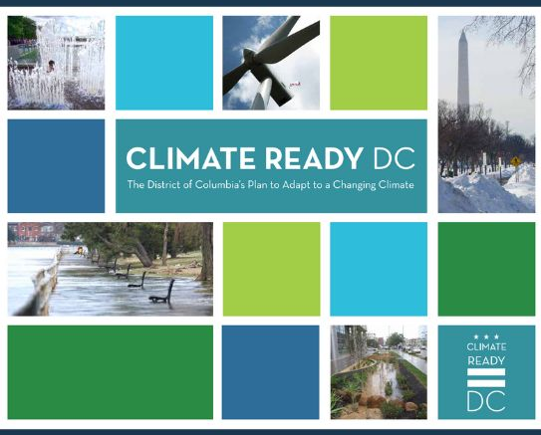
DOEE Updates
Happening at DOEE
DOEE/CCCR Oversight Hearing
Climate Ready DC – Update in progress
District Sustainability Awards – Presented yesterday
RFA: Community Stormwater Solutions Grant Program
RFA: DC Energy Storage Grant Program (Round 2)
Round 1 Grantee: Faunteroy Community Enrichment Center
Federal funding in the District
Climate Pollution Reduction Grant
Notes:
DOEE/CCCR Oversight Hearing
On February 29, CCCR Chair Uwe and the heads of DOEE, DC Water, DC Green Bank, and DCSEU testified in front of the DC Council Committee on Transportation and the Environment, chaired by Councilmember Charles Allen. The hearing included testimony from nearly 80 public witnesses.
Climate Ready DC Update
DOEE and HSEMA are currently collaborating on updates to Climate Ready DC, the District's climate adaptation plan, and the climate adaptation chapter of Resilient DC. DOEE intends to update CRDC to incorporate new climate science, apply a racial equity lens, better support agencies to implement the plan, and clarify its role compared to other District plans. The agencies have hosted two of four planned interagency workshops, and are launching public engagement effort this month.
District Sustainability Awards
The District Sustainability Awards highlight businesses, individuals, and organizations that are working towards a more sustainable DC. Awardees’ projects and programs support the Mayor’s Sustainable DC Plan, which aims to make the District the nation’s greenest, healthiest, most sustainable city; it encompasses equity, governance, education, built environment, climate, economy, energy, food, nature, transportation, waste, and water. Winners were announced at an event on March 13.
Request for Applications - Community Stormwater Solutions Grant Program
The Chesapeake Bay Trust and the Department of Energy and Environment partnered on this program to provide up to $35,000 in funding to support community-oriented and inspired projects that are designed to increase knowledge and lead to behavior change as it relates to watershed and stormwater-related issues. This grant can fund activities such as educational events/workshops, installation and maintenance of runoff-reducing green infrastructure, art installations, restoration of habitat, litter or pollution reduction, or other project types that meet the goals of the grant program. For more information, please visit https://cbtrust.org/grants/district-of-columbia-community-stormwater-solutions/. Applications are due March 28.
Request for Applications - DC Energy Storage Grant Program (Round 2)
The Department of Energy and Environment seeks eligible entities to apply for the Energy Storage Grant Program to maximize the benefits of renewable energy in the District by deploying and integrating battery energy storage systems in commercial buildings and multifamily residential buildings with five or more units. The amount available for the project is $3,560,494. For more information, please visit https://doee.dc.gov/node/1709011. Applications are due April 12.
Faunteroy Community Enrichment Center – Energy Storage Grant
DOEE is pleased to announce the award of $540,000 to the F.H. Faunteroy Community Enrichment Center (Faunteroy Center) for the development of a microgrid system to support the Center’s role as a resilience hub. The system is composed of solar, battery storage, and a controller that will provide clean backup power while the electric grid is down. The Faunteroy Center will break ground on this at an event next week that will celebrate this grant and all of the progress they have made over the past several years.
Federal funding in the District
DOEE has published a webpage showing recent and upcoming awards of federal funds flowing into the District.
Climate Pollution Reduction Grant
DOEE submitted the District and Regional Priority Climate Action Plans (PCAPs) on March 1st to EPA and is working with regional partners to put forth competitive grant applications to implement priority measures identified in the PCAP. CPRG implementation grant applications are due on April 1.

Slide 3
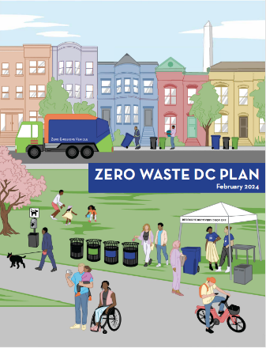
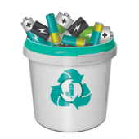
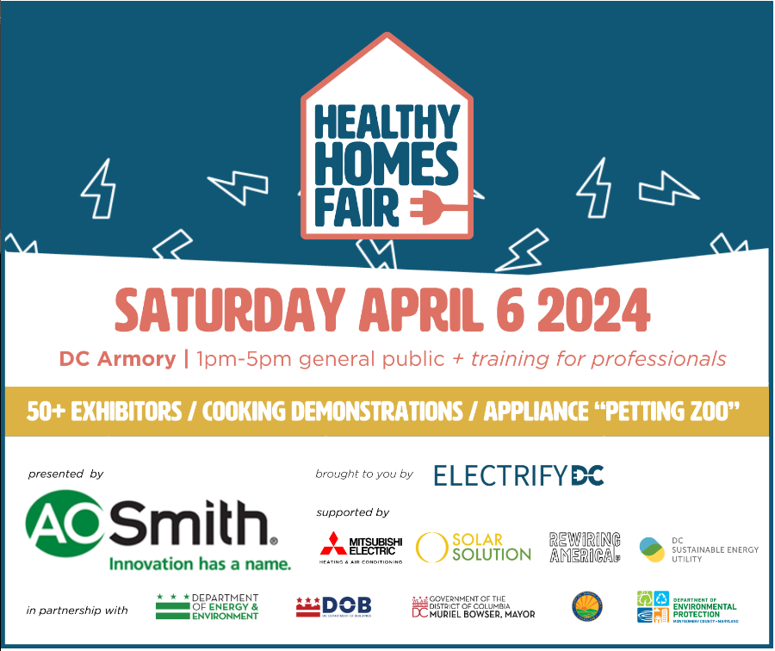
District Updates
Happening around the District
Zero Waste DC Plan – Released
Call2Recycle – Seeking battery recycling collection sites
Electrify DC Healthy Homes Fair – April 6, 2024
APACC|DCA Health Equity Working Group
PSC Formal Case 1154: PROJECT Pipes 2 Extension
Notes:
Zero Waste DC Plan Released
Under the Sustainable DC Plan, the District established an ambitious zero waste goal to divert 80% of the entire citywide waste stream away from landfill and incineration towards its highest and best use. On February 22, the Bowser Administration released the Zero Waste DC Plan, a strategic roadmap to accomplish this goal through cost-effective and sustainable solid waste management.
The Zero Waste DC Plan outlines a series of actions and policies that together would divert almost one million tons of DC’s solid waste annually, lower DC’s greenhouse gas emissions by over one million metric tons annually, and create 300 green jobs within District government. The Plan was developed through eight years of research and analysis, collaboration between District agencies and external stakeholders, and 20 community events and several public surveys that allowed residents to provide feedback, ideas, and solutions aimed at reducing DC’s waste footprint.
DPW is hosting a Zero Waste DC Community Fair to celebrate the plan’s release on Saturday, March 30, 10am-1pm, at Eastern Market.
Battery Recycling Program - Host a Battery Collection Site
As of November, consumers in the District can now drop off household batteries for recycling at designated sites throughout the city. The program was developed in compliance with District law and regulations by Call2Recycle, the District’s battery stewardship organization, on behalf of battery manufacturers. The collection sites accept both single-use and rechargeable batteries at no cost to consumers for collection and recycling. The program coordinator, Call2Recycle, is inviting businesses, libraries, office buildings, government agencies, and retailers to participate as battery collection sites. These sites are a cornerstone of the recycling program and participation is free! If your organization is interested, please reach out to Call2Recycle at customerservice@call2recycle.org to learn more.
Healthy Homes Fair on April 6
The Healthy Homes Fair is a free expo and interactive experience for homeowners, renters, home renovation professionals, and career seekers to learn about the products and services needed to improve our health, increase comfort, and reduce emissions from the homes of the DC region. The Fair is organized by Electrify DC, a nonprofit that is transforming the residential real estate market and the professions that serve it by bringing together real estate professionals, contractors of all kinds, government agencies, and the public to showcase the cost savings, health and climate benefits of electrification through education, training, and advocacy. The Fair will serve as a training ground for professionals, businesses, and people looking to join the clean energy workforce. The Fair will empower homeowners and renters to make the transition to clean energy by showcasing products and services including heat pumps, induction cooktops, heat pump water heaters, heat pump dryers, EV chargers, battery storage, small plug-in vehicles, electric lawn tools, electrical panel components, rooftop solar, and other renewable energy solutions.
APACC|DCA Health Equity Working Group
Join APACC, DC Appleseed, and other community partners in exploring the intersection of environmental justice and health equity through a year-long series of workshops. The group will:
-Identify the health and environmental issues most directly impacting Wards 7 and 8;
-Plan online sessions to learn about key topics from researchers, academics, local advocates, and our neighbors;
-Develop a public health platform for APACC that promotes equitable strategies for mitigating the impacts of climate change on Wards 7 and 8; AND
-Offer resources, workshops, and opportunities for APACC members and Ward 7 and 8 residents to advocate for increased resiliency, wellness, and equity. The first working group meeting is on Tuesday, March 26 at 10AM.
PSC Formal Case 1154: PROJECT Pipes 2 Extension
On February 23, the Public Service Commission voted to grant Washington Gas Light Company (WGL) a 12-month, $57.3M extension to their PROJECT Pipes 2 plan. The PSC had previously authorized $150M over three years. The PSC received letters of opposition from many stakeholders, including ten DC Councilmembers. Commissioner Beverly voted to oppose the motion.
On February 13, the Office of the People’s Counsel filed a petition to investigate WGL’s “handling of natural gas leaks on its distribution system.”

Slide 4
Administrative Updates
Administrative
Welcome new DOEE staff: Tasneem Islam
Welcome new Commissioners: Akiima Price & Kate Johnson

Slide 5
Next Meeting
Thursday, June 13, 2024

