Slide 1
District of Columbia Commission on Climate Change & Resiliency Quarterly Meeting
Staff Updates September 14, 2023

Slide 2
AGENDA
Call to Order
Announcement of Quorum
Approval of Agenda
Approval of Previous Meeting Minutes
Chair’s Welcoming Remarks
Finance Report
Governance Report
Committee Reports
Staff Report
Guest Presentations
Public Service Commission: Richard Beverly, Commissioner, PSC
HSEMA’s Role in Coordinating Responses: Melissa Deas, Chief Resilience Officer, HSEMA
Green Building Advisory Council’s Embodied Carbon Policy Recommendations: Anica Landreneau, Global Sustainable Design Director, HOK; GBAC Private Sector Representative; BEPS Task Force Co-Chair
Sustainable DC Progress and Update: Oana Leahu-Aluas, Program Analyst, DOEE
Governance Discussion
Public Comments
Discussion & Upcoming Meetings
Adjournment

Slide 3
Staff Updates
Administrative
New CCCR Commissioner: Erica “Go” Green
CCCR vacancies
Emergency Preparedness
Public Health
Website updates
Notes:
Erica “Go” Green is the newest Council-appointed Commissioner on the CCCR.
Two CCCR vacancies:
-Emergency Preparedness and Public Health
-Seeking candidates who live in the District, preferably with deep local roots.
-Send candidate recommendations to Uwe and Connor.
CCCR member pictures and bios have been updated: https://climatecommission.dc.gov/page/members-staff
Send any additional revisions to Connor.

Slide 4
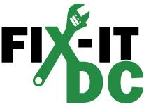
Staff Updates
Happening at DOEE
Confirmation hearing for Acting Director Richard Jackson – Sept 21
Federal funding in the District
Climate Ready DC – Climate Projections Update
Ears & Eyes on the Environment Podcast
Sustainable Business Registry
Kingman Island Friends & Family Day
Fix-it DC Repair Clinics
Notes:
Agency Leadership Changes
DC Council Committee on Transportation & the Environment will hold a public confirmation hearing for DOEE Acting Director Richard Jackson on Thursday, September 21 at 1 pm.
Additionally, the confirmation hearing for DOB Acting Director Brian Hanlon is scheduled for October 18.
DDOT Director Everett Lott will leave his post at DDOT later this month.
Federal funding in the District
DOEE has published a webpage showing recent and upcoming awards of federal funds flowing into the District.
DOEE has also submitted a letter of intent to apply for the National Oceanic and Atmospheric Administration’s Climate Resilience Regional Challenge (https://coast.noaa.gov/funding/ira/resilience-challenge/), a funding opportunity made possible by the Inflation Reduction Act. If awarded, this would support a suite of resilience activities including an expansion of the District’s network of community-led resilience hubs in climate-vulnerable neighborhoods. DOEE would issue competitive grants to three pre-existing community facilities to implement resilient design features and power systems and to create and adopt a resilience hub operation plan.
Climate Ready DC – Climate Projections Update
DOEE is collaborating with HSEMA to update the District of Columbia’s official climate change projections. Based on the best available science and tools, the resulting report will provide a forecast of the impacts of climate change that are likely to occur in the District, including increased frequency and duration of extreme heat and flooding events.
Eyes & Ears on the Environment
Welcome to DOEE's official podcast, Ears & Eyes on the Environment. This channel focuses on DOEE's purpose and provides insights on the agency's values and mission. Topics include energy and environment related issues and their effects on residents and businesses of the District. Most recent episodes discuss flooding and air quality.
Sustainable Business Registry
DOEE is launching a new service to assist businesses interested in improving their sustainability and environmental footprint. It’s free to join by completing a questionnaire on DOEE’s website.
Kingman Island Friends & Family Day
Explore Kingman + Heritage Islands on Saturday, October 14, 2023, from 10:00am – 2:00pm, with your family and friends! Experience all the amazing activities the islands offer including paddling, nature walks, fishing, scavenger hunts, and so much more!
Fix-It DC
Fix-It DC hosts community repair events dedicated to changing the “throw-it-away” mentality. Visitors bring their broken items to the Fix-It DC Event where volunteer Fix-It coaches provide guidance in troubleshooting how to repair each item.
The next event is scheduled for Wednesday, September 20, 5:30-7:30 pm at Martin Luther King Jr. Memorial Library (901 G St NW).

Slide 5
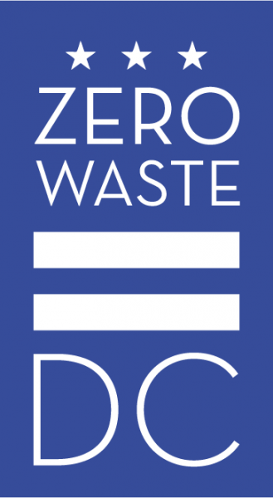
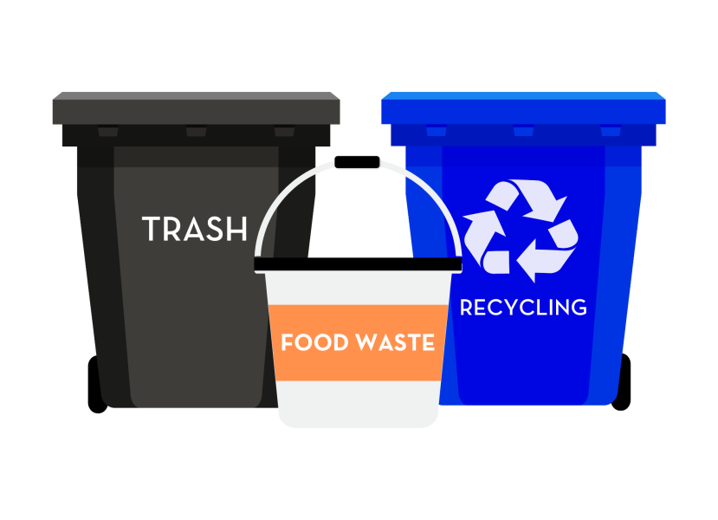
Staff Updates
Happening around the District
DPW – Curbside Compost Pilot Program
Community Forklift – Free deconstruction services
DDOT – Climate Change and our Urban Forest StoryMap
Southwest Neighborhood Assembly – Climate Action & Disaster Preparedness Fair
German Embassy – Opening celebration: Women in Climate Action mural by German artist Hera
Notes:
Curbside Compost Pilot Program
The Department of Public Works' Office of Waste Diversion has launched the Curbside Composting Pilot Program, which will provide curbside food waste collection from single-family households in the District of Columbia. Pilot will run for one year. The program is not accepting new applicants at this time.
Community Forklift Deconstruction Services
DOEE awarded an innovation grant to Community Forklift (a local non-profit) to provide free deconstruction services to District residents and businesses. Deconstruction is like construction in reverse. It involves the careful dismantling of a building so that materials can be salvaged for reuse rather than dumped in a landfill. Community Forklift provides many of the salvaged materials to low-income residents and community partners through their Home Essentials Program and their Community Building Blocks program. Other materials are sold at discounted prices at their Reuse Center in Prince George's County.
Climate Change and our Urban Forest
Here in the District, we are relying on our urban forest to help us adapt to future climates that are projected to bring extreme heat, higher average temperatures, and changes in precipitation. But the trees themselves are vulnerable to those same changes. As stewards of the urban forest, the Urban Forestry Division has been working to better understand what is at risk, who is at risk, and how to adjust our management practices to maintain an urban forest that is healthy, safe, and growing, even within a changing climate.
All Hands on Deck Climate Action & Disaster Preparedness Community Engagement Fair
This event will be held on Saturday, September 23, 9am-1pm, at the SW Farmers Market (4th and M Streets SW). The event will include presentations, workshops, and 30+ exhibitors.
Women in Climate Action Mural
The German Embassy Washington and Street Art for Mankind (SAM) are excited to celebrate the opening of a massive climate action mural by German artist Hera in the Mount Vernon Triangle neighborhood of Washington, DC, to accelerate awareness of climate change and the essential role that women play in tackling the issue. Join us for an opening ceremony featuring remarks by top officials, uplifting music by award-winning singer/songwriter Emma G, and light refreshments courtesy of the German Embassy Washington.
Mount Vernon Triangle Community Improvement District extended an invitation to an opening celebration on September 15 at 5 pm.

Slide 6
Next Meeting
Thursday, Dec 14th

