Slide 1
CLEAN ENERGY DC 2.0
THE DISTRICT OF COLUMBIA CLIMATE AND ENERGY PLAN

Slide 2
Planning Principles
Transformational
CEDC 2.0 should seek big, transformative solutions to fundamentally redesign and decarbonize the energy, buildings, and transportation sectors, in order to meet the goal of becoming carbon neutral by 2045.
Actionable
CEDC 2.0 should create real-world, tangible solutions that can be implemented by public and private sectors.
Coordinated and integrated
CEDC 2.0 should take a holistic approach, recognizing decisions made in one sector impact other sectors and the larger system; this plan will complement existing and ongoing initiatives.
Technical and data-driven
CEDC 2.0 should be a highly technical plan that will use the best available data to guide the actions and recommendations.
Participatory
CEDC 2.0 should prioritize community and stakeholder involvement. The level of transformation required to tackle climate change will impact all of us, and therefore decisions should be made in collaboration with our communities, particularly low-income communities and communities of color that have borne disproportionate share of burdens from climate pollution, and whose needs must be centered.

Slide 3
Values and Co-Benefits
Equity and environmental justice – Potential to on low-income communities and communities of color.
Public health – Potential to enhance healthy living, physical comfort, and mental wellness.
Economic prosperity – Potential to stimulate local business, economic development, and job opportunities.
Environmental stewardship – Potential to positively impact natural systems, biodiversity, air quality, and water quality.
Resilience and reliability – Potential to increase local adaptive capacity to respond to climate change impacts, and secure reliable energy services.

Slide 4
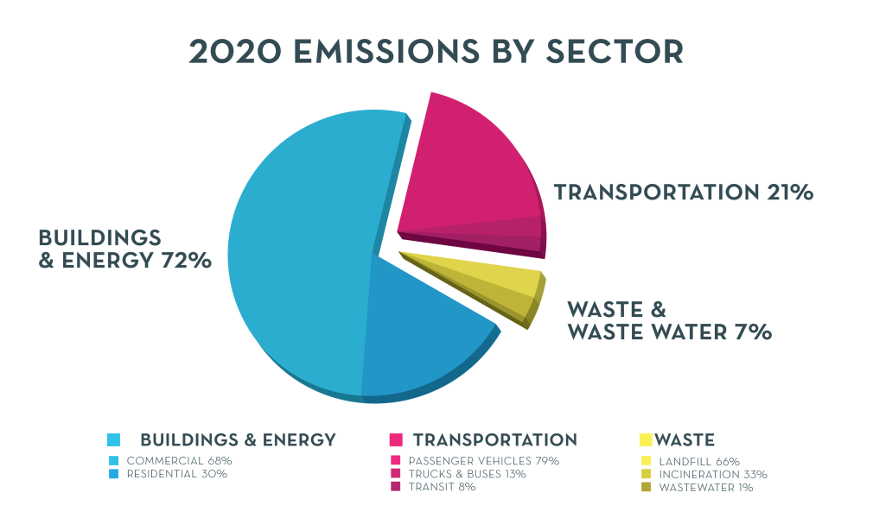
Greenhouse Gas Emissions

Slide 5
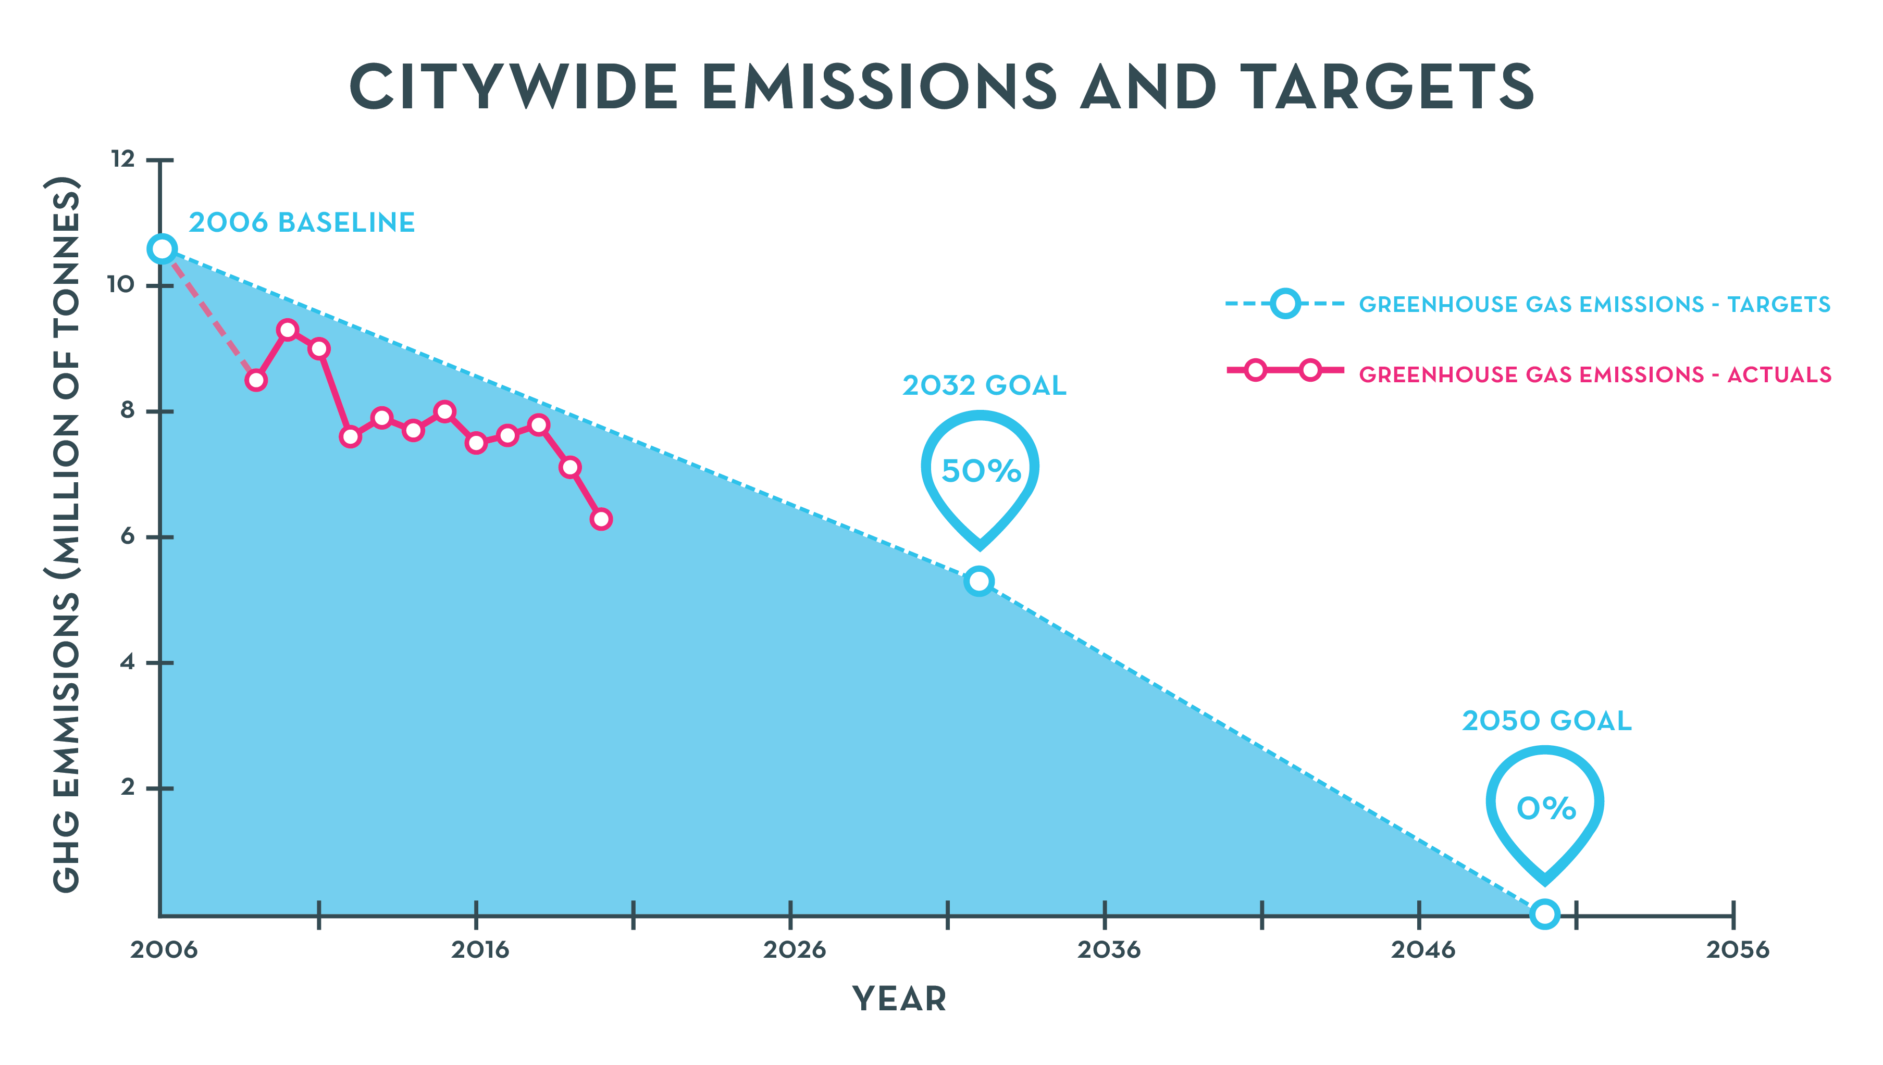
Citywide Emissions and Targets
Notes:
The District’s emissions have already shrunk 40% since 2006, largely due our grid moving off of coal-fired power plants. There is a long way to go to reach our 2032 and 2050 goals and that will have to come from actions within the District. The Clean Energy DC plan charts the pathway to the 2032 goal, and this work is now to develop our strategy for how we achieve the 2050 goal.

Slide 6
INTRODUCTION TO CLEAN ENERGY DC 2.0

Slide 7
Potential CEDC 2.0 Targets
REDUCE
ELECTRIFY
CLEAN SUPPLY
Cut per capita energy use by 50% by 2032
Zero fossil fuel use by 2045
24/7 100% clean power supply by 2045
ACHIEVE CARBON NEUTRALITY
60% reduction in GHG emissions by 2030
100% reduction by 2045

Slide 8
Preliminary Carbon Free DC draft- does not reflect new 2045 carbon neutrality date

Slide 9
DC-DCCR Report CEDC2.0
Accelerate transition to Clean Energy
Actions 1-3 will be incorporated into the draft, as well as embodied carbon (4.3)
Anticipate Climate Risks
CEDC2.0 will have a greater resiliency focus than current version
Empower All Communities
8,10 will be reflected in the draft, and 11 is being considered

Slide 10
New or expanded topics being considered
Embodied Carbon
Resilient design
Building electrification & transition to clean thermal energy
Peak demand and demand management
Transport/building electrification and the grid
Economic development

Slide 11
Contact
Jamie.Donovan@dc.gov

