Slide 1
District of Columbia Commission on Climate Change & Resiliency Quarterly Meeting
Staff Updates June 8, 2023

Slide 2
AGENDA
1. Call to Order
2. Announcement of Quorum
3. Approval of Agenda
4. Approval of Previous Meeting Minutes
5. Chair’s Welcoming Remarks
6. Finance Report
7. Governance Report
8. Committee Reports
9. Staff Report
10. Presentations
a. Public Service Commission Updates: Danielle Gurkin (PSC)
b. Strategic Electrification Roadmap: Katya Botwinick (DOEE)
c. BEPS Update: Katie Bergfeld (DOEE)
d. Clean Energy DC 2.0: Jamie Donovan (DOEE)
11. Panel Discussion: Commercial Buildings in a Post-Pandemic Marketplace
a. Theresa Backhus (Building Innovation Hub)
b. Andrea Foss (Steven Winter Associates)
12. Public Comments
13. Discussion & Upcoming Meetings
14. Adjourn

Slide 3
Staff Updates
Administrative
DOEE & Other Activities
New Commissioner: Erica “Go” Green
CCCR vacancy: Emergency Prep
New staff executive: Connor Rattey
DOEE – 2023 District Sustainability Awards
Casey Trees – 2022 Tree Report Card
Notes:
Erica “Go” Green is the newest Council-appointed Commissioner on the CCCR.
One CCCR vacancy:
-Emergency Preparedness (formerly filled by Sandra Knight) – Mayoral appointment
Connor Rattey has filled the DOEE position to support the CCCR.
Congratulations to the winners of the 2023 District Sustainability Awards and the Clean Energy DC Award:
-Dumbarton Oaks Park Conservancy
-Farmers Restaurant Group
-Goodwill of Greater Washington
-Sycamore & Oak
-MetLife Investment Management (Clean Energy DC Award)
Casey Trees publishes an annual report card that measures progress toward achieving the District’s 40% tree canopy goal, and the extent and condition of DC’s trees. According to the 2022 report card, the District lost 1%, or 565 acres, of its tree canopy between 2015 and 2020. The District received an A+ for tree planting, but an F for tree protection. The report includes recommendations to improve this performance, including increasing tree removal fees to account for inflation.

Slide 4
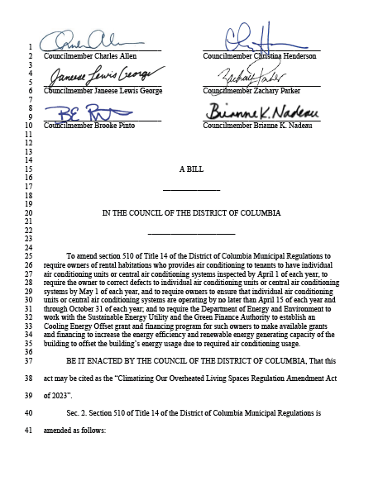
Council Updates
B25-0279 - Climatizing Our Overheated Living Spaces Regulation Amendment Act of 2023
Landlords who provide AC must have the systems operational between April 15 – October 31 (currently required between May 15 – Sept 15).
Inside temperatures must be 15° F less than outside temperatures.
DOEE, DCSEU, and DC Green Bank to establish a Cooling Energy Offset grant/financing program to assist building landlords with compliance.
Notes:
As introduced, this bill would amend the DCMR (Title 14 Section 510) to require landlords who provide air conditioning to maintain the air conditioning units or systems to provide inside temperatures 15° F less than outside temperatures between April 15 and October 31 of each year (currently required between May 15 and September 15). Units would be maintained between September 1 and April 1, and any defects discovered would have to be corrected by May 1. The bill also clarifies that landlords must report to the Department of Buildings regarding air conditioning unit or system maintenance.
This bill would also require the Department of Energy and Environment, the Sustainable Energy Utility, and the Green Finance Authority to establish a Cooling Energy Offset program to provide to grants and financing to owners of rental buildings who are subject to the air conditioning regulations, in order to increase the energy efficiency and renewable energy-generating capacity of the buildings and to offset the required increased energy use.
This bill was introduced by Councilmembers Henderson, Pinto, Parker, Lewis George, Allen, and Nadeau on April 27, 2023. It has been referred to the Committee on Transportation and the Environment and Committee of the Whole.

Slide 5
Next Meeting
Thursday, Sept 14th

