Slide 1
Strategic Electrification Roadmap
Department of Energy and Environment
June 8, 2023

Slide 2
Background
Funded by U.S. DOE
Goal: outline the scope and scale of energy efficiency and electrification measures needed to meet the District of Columbia’s climate targets as delineated in the Clean Energy DC Plan.
Public and confidential versions
Filed in FC 1167 and posted on the Clean Energy DC website: https://doee.dc.gov/cleanenergydc

Slide 3
Tasks
Task 1: Building Electrification
Task 2: Light-Duty Vehicle Electrification and Bus Electrification
Task 1 & 2: Combined Electrification Loads
Task 3: Grid Emissions Assessment
Task 4: Grid Analysis
Task 5: Grid Impact Mitigation

Slide 4
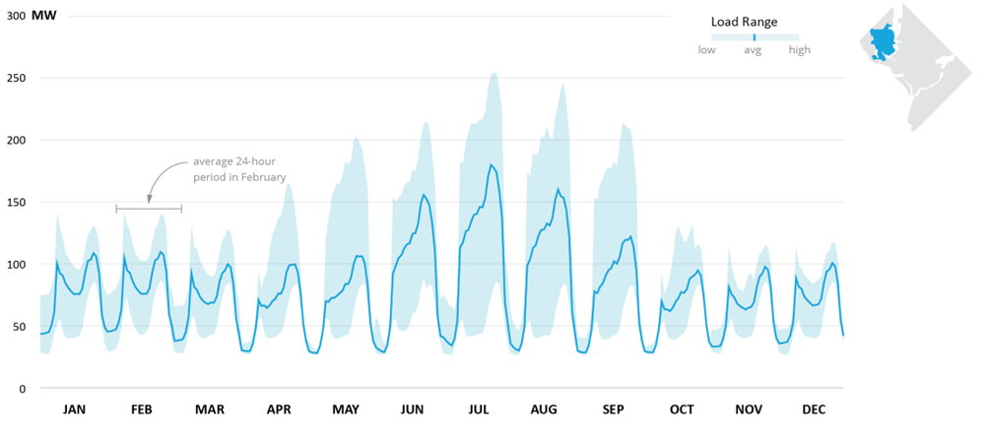
Task 1
Figure 11: 2032 Average day electric load profile, Scenario 2, substation 129.

Slide 5
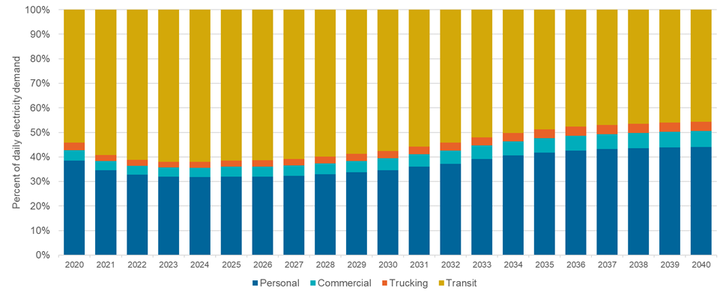
Task 2
Figure 22: Electricity demand share by Vehicle type: Accelerated Scenario

Slide 6
Tasks 1 & 2
Presents the combined loads for building and transportation electrification that the District may experience in 2032, by using the “worst-case” summer and winter peak days from building loads
None of the loads exceed the substation capacity, although they do approach the maximum in some cases
The time of greatest stress on the substations is 7AM on winter mornings
Because building electrification loads do not add substantially to summer peaks, no substation peak load exceeds 80 percent of its capacity in the summer

Slide 7
Task 3
The evolution of the building fleet between today and 2032 will result in a 36-41% decrease in CO2 emissions, depending on the energy efficiency scenario
By 2050, the electrical energy consumption for EV charging in the District will increase by up to 62 times the usage from 2019, which is up to 300 MWh per year
For a given load on the grid, the GHG impact can be reduced by shifting the usage to the times of lower marginal carbon intensity. For the future EV fleet, carbon emissions reductions of 3-12% can be expected on an annual basis through smart-charging with an emissions-optimal control scheme.

Slide 8
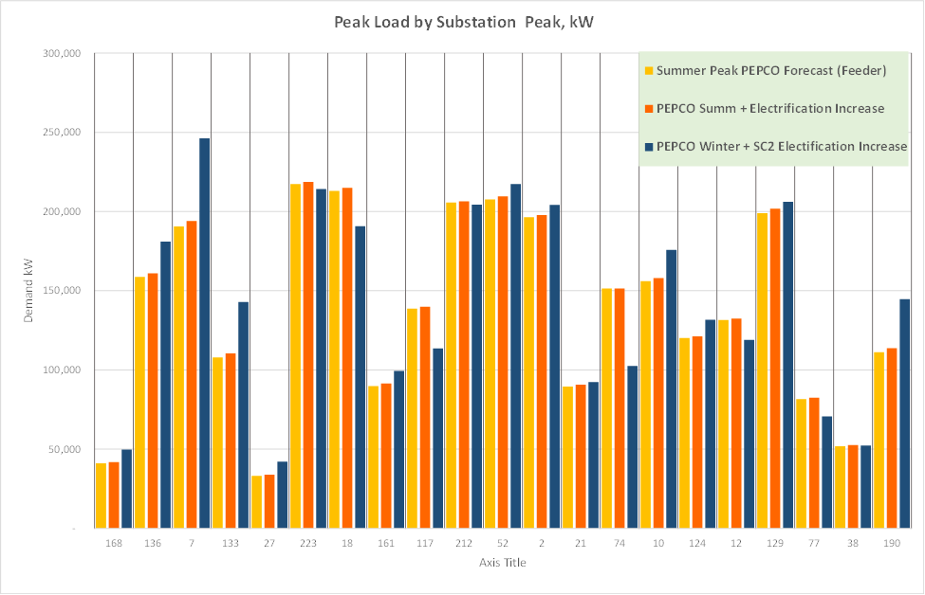
Task 4

Slide 9
Task 5
Key insights for grid planning:
Many feeders do not require investment for at least another decade
Anticipation of future grid state is important for solution planning
Distributed Energy Resources (DERs) could play a substantial role in wholesale markets as the grid shifts toward zero carbon supplies
Cost estimates of traditional components and DERs have a large impact on relative economics
Local resilience needs could shape investment patterns

Slide 10
Conclusions
Pepco’s system is well-equipped to handle projected electrification loads from buildings and transportation to 2032.
Beyond 2032, electrification loads will continue to increase, highlighting the important role for energy efficiency and DER to play in mitigating these new loads.
The District should continue to embrace fuel-switching policies to stay on track to meeting its climate mandates.
Next priorities:
Integrated distribution system planning/grid modernization
Implementing a benefit cost test
Continued intervention in key PSC cases like Formal Case 1175 (PROJECTpipes 3)

Slide 11
QUESTIONS

